Slide 1
Banking Crisis in 2023:
Not-So-Big Too Big To Fail banks?
Panelists
Donald Bernstein, Davis Polk
Lisa Schweitzer, Cleary Gottlieb
Prof. Ignacio Tirado, SG Unidroit and Universidad Autonóma Madrid
Moderated by prof. Rolef de Weijs, UvA & Houthoff
June 12, 2023, 13:00 – 14:15

Slide 2
Outline
I) Development from 2008 onwards: Resolution & Capital (25 min)
    Dodd Frank & Single Point of Entry, TLAC/MREL and liquidity requirements (15 min)
    BRRD and EU rules (10 min)
II) What worked and what did not? (25 min)
  US Experience (15 min)
    US: SVB (10 min)
    US: First Republic and Signature (3 min)
    Was focus on large banks too narrow? How different are small banks from big banks? (2 min)
  European Experience (10 min)
    Banco Popular (Spain), BBRD applied
    Swiss experience, in Europe but outside EU
III) Policy debate and way forward (25 min)

Slide 3
Hypothetical Single Point of Entry Resolution of
U.S. Bank Holding Company under the U.S. Federal Bankruptcy Code

Slide 4
Single Point of Entry Resolution Under Bankruptcy Code
HYPOTHETICAL FINANCIAL INSTITUTION STRUCTURE FOR DISCUSSION
Financial Institution
Public Shareholders
Bank Holding
Company
Bank
Domestic
Broker-Dealer
Foreign
Broker-Dealer
Foreign Bank
Branch
Foreign
Subsidiary
Note: This is a hypothetical and greatly simplified U.S. financial institution structure. The location of various legal entities, including whether they are in a separate legal chain or in a chain with a domestic insured bank, varies from firm to firm. Asset management entities are not shown.

Slide 5
Single Point of Entry Resolution Under Bankruptcy Code
HYPOTHETICAL FINANCIAL INSTITUTION STRUCTURE BEFORE FINANCIAL DISTRESS (cont.)
Top-Tier BHC Stand-alone Balance Sheet ($bn)*
Assets |  |  | Liabilities
Cash and Other HQLAs BHC Deposits in Bank Advances to Domestic Broker-Dealer Advances to Foreign Broker-Dealer | 25 35 15 10 |  | Unsecured long-term debt (external TLAC debt) | 100
Equity of Bank Equity of Domestic Broker-Dealer Equity of Foreign Broker-Dealer Other Assets | 75 15 10 15 |  | Unsecured short-term debt | 0
 |  |  | Equity | 100
Total | 200 |  | Total | 200
These BHC assets can be used to recapitalize and provide liquidity to OpCos after the onset of financial distress
External TLAC
* The figures used in this SPOE hypothetical are meant to be illustrative only.
Note: This is a BHC stand-alone balance sheet, which shows only BHC investments in OpCos, and not the OpCos’ assets and liabilities. A consolidated balance sheet would show that the firm has $850bn – $1tn in assets.

Slide 6
Single Point of Entry Resolution Under Bankruptcy Code
HYPOTHETICAL LOSSES
Public Shareholders
Losses in Subs ($bn)
Bank: $40 Loss
$35 Remaining Equity
Domestic Broker-Dealer:
$5 Loss
$10 Remaining Equity
Foreign Broker-Dealer:
$5 Loss
$5 Remaining Equity
Bank Holding
Company
Total Losses: $50 bn
Remaining BHC Equity: $50 bn
Bank
Domestic
Broker-Dealer
Foreign
Broker-Dealer
Foreign Bank
Branch
Foreign
Subsidiary

Slide 7
Single Point of Entry Resolution Under Bankruptcy Code
HYPOTHETICAL LOSSES (cont.)
Top-Tier BHC Stand-alone Balance Sheet After Losses and Before Recapitalization ($bn)
Assets |  |  | Liabilities
Cash and Other HQLAs BHC Deposits in Bank Advances to Domestic Broker-Dealer Advances to Foreign Broker-Dealer | 25 35 15 10 |  | Unsecured long-term debt | 100
Equity of Bank Equity of Domestic Broker-Dealer Equity of Foreign Broker-Dealer Other Assets | 75→35 15→10 10→5 15 |  | Unsecured short-term debt | 0
 |  |  | Equity | 100→50
Total | 200→150 |  | Total | 200→150

Slide 8
Single Point of Entry Resolution Under Bankruptcy Code
OPCOS RECAPITALIZED AND PROVIDED LIQUIDITY PRIOR TO BHC BANKRUPTCY
Top-Tier BHC Stand-alone Balance Sheet After Recapitalization Actions ($bn)
Assets |  |  | Liabilities
Cash and Other HQLAs BHC Deposits in Bank Advances to Broker-Dealer 1 Advances to Broker-Dealer 2 | 25→2 35→0 15→0 10→0 |  | Unsecured long-term debt | 100
Equity of Bank Equity of Broker-Dealer 1 Equity of Broker-Dealer 2 Other Assets | 35→93 10→25 5→15 15 |  | Unsecured short-term debt | 0
 |  |  | Equity | 50
Total | 150 |  | Total | 150
Contributions of capital and liquidity to OpCos must be structured to be resilient against avoidance and other legal challenges in BHC bankruptcy proceedings.
After providing capital and liquidity to its OpCos pursuant to secured Support Agreement, the BHC commences chapter 11 proceedings and immediately files transfer motion

Slide 9
Single Point of Entry Resolution Under Bankruptcy Code
TRANSFER OF OPCOS TO DEBT-FREE NEW HOLDCO OWNED BY TRUST FOR BENEFIT OF BANKRUPTCY ESTATE OF BHC
  Recapitalized OpCos are transferred to New HoldCo owned by Resolution Trust for benefit of
  BHC’s bankruptcy estate pursuant to Section 363 Transfer Order
Left-behind debts of BHC
subject to plan of reorganization
Trust
BHC
in chapter 11
proceedings
(debtor in possession)
New HoldCo
Beneficiary
Guarantee Obligations of OpCos’ QFCs assumed by New HoldCo
Transfer Pursuant to
Sale Order
Claims left behind
Long-term debt: 100
Recapitalized
Bank
Recapitalized
Domestic
Broker-Dealer
Recapitalized
Foreign
Broker-Dealer
Foreign Bank
Branch
Foreign
Subsidiary

Slide 10
Single Point of Entry Resolution Under Bankruptcy Code
NEW HOLDCO STAND-ALONE BALANCE SHEET
New HoldCo Stand-alone Balance Sheet ($bn)
Assets |  |  | Liabilities
Cash and Other HQLAs | 1 |  | Unsecured long-term debt | 0
Equity of Bank Equity of Broker-Dealer 1 Equity of Broker-Dealer 2 Other Assets | 93 25 15 15 |  | Unsecured short-term debt | 0
 |  |  | Equity | 149
Total | 149 |  | Total | 149
Only some of the BHC’s liquid resources are transferred to New HoldCo; the remainder is left behind in the BHC to cover chapter 11 administrative expenses (not shown here). This is New HoldCo’s balance sheet. As adjusted, $1 billion is transferred to New HoldCo, and $1 billion is left behind in the BHC’s bankruptcy estate.
Capital Levels of recapitalized OpCos and New HoldCo exceed pre-loss levels to facilitate stabilization*
* The New Holdco will be required to comply with capital requirements generally applicable to fully capitalized and open bank holding companies.

Slide 11
Readiness for Resolution Using Single Point of Entry Recapitalization
Resolution Readiness Mandated for G-SIBs by US Regulators
Ex ante TLAC and liquidity requirements
  Structural feature — bank holding company with sufficient bail-in resources that can be put into bankruptcy
  Sufficient Bail-in Resources to Recapitalize the Group — External TLAC and Internal TLAC
  Liquidity Coverage Requirements (ability to meet a run)
  ISDA Protocol and QFC regulations
  Resolution planning — detailed preparation for implementation (support agreement, court papers, transfer documents)
  Framework for cross-border regulatory cooperation
  Structural enhancements: intermediate holding company

Slide 12

THE EU legal framework: BRRD AND SRMR

Slide 13
Creation of a Single Rulebook, ‘top-up’ for eurozone
SRMR:
  creating a centralized European system of resolution, aimed to eradicating national supervisory forbearance
  covering all SSM countries: euro area countries and EU non-euro countries participating to the SSM
SSM
SRM
Coordination
(EBA and colleges)
Non BU
authorities
Single rulebook - EU
CRR/CRD IV
BRRD and DGSD
BRRD:
  creating a set of common resolution tools and procedures
  covering all EU Member States

Slide 14
Fundamental Principles & Resolution Objectives
Provide authorities with a credible set of tools to intervene sufficiently early and quickly in a failing institution
Ordinary insolvency procedures not sufficiently rapid: need of special administrative procedures
Cost of crises must not be offloaded onto taxpayers: shareholders must bear first losses, then creditors
Public resources may be resorted to only as a last resort, and only after the private sector has absorbed a certain amount of losses
Creditors must not be inflicted higher losses than under ordinary insolvency procedures (“no-creditor-worse-off” principle)
to ensure the continuity of critical functions;
to avoid significant adverse effects on financial stability, in particular by preventing contagion, including to market infrastructures and by maintaining market discipline
to protect public funds by minimising reliance on extraordinary public financial support;
to protect depositors covered by the Deposit Guarantee Scheme Directive (DGSD) and investors covered by the Investor Compensation Scheme Directive (ICSD);
to protect client funds and client assets.

Slide 15
Division of tasks within the SRM
SRB
NRAs
Significant banks and banking groups
Other banks/banking groups subject to ECB supervision
Other cross-border groups
Manage the Single Resolution Fund (SRF)*
Less-significant banks and banking groups (i.e. subject to NCA supervision)
Entities that fall outside the scope of the SRMR
Manage the national resolution funds
Execution of resolution schemes
Draft resolution plans, MREL,
resolution scheme
Guidelines, general instructions, warnings
Internal Resolution Teams (IRTs)
* Any resolution action involving the SRF → SRB

Slide 16
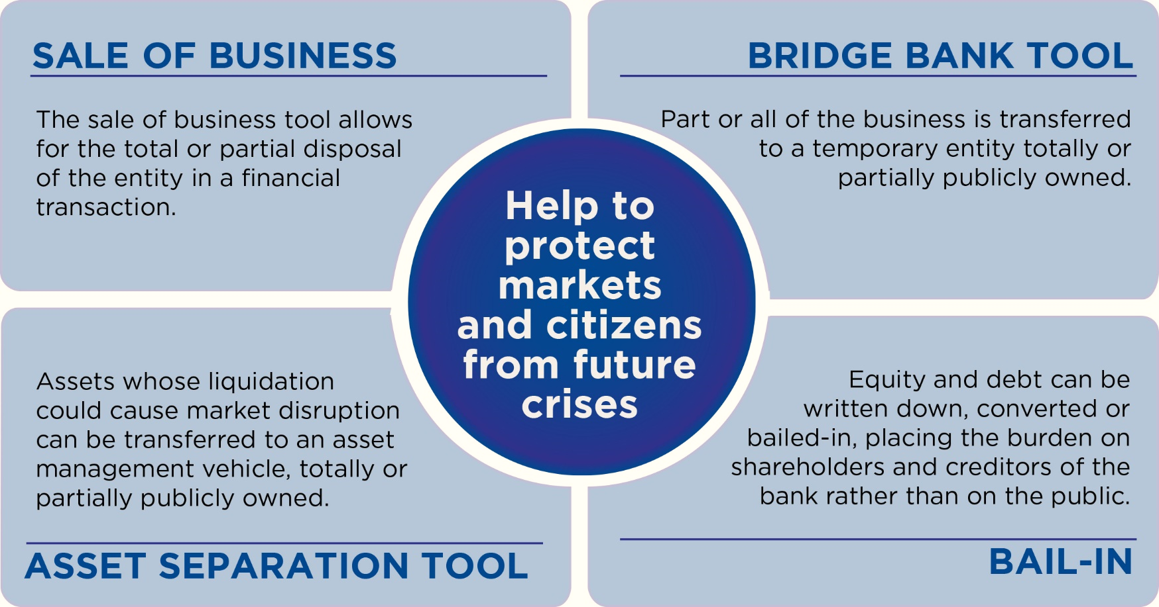
Resolution tools
All these tools are to be financed with private resources
→ Module II

Slide 17
3 Phases
Preparation and prevention
Early intervention
Resolution
Recovery plans, prepared by banks
Resolution plans, prepared by resolution authorities in cooperation with banks
Resolvability assessment, removal of potential obstacles to resolution
Minimum Requirement for own funds and Eligible Liabilities (MREL)
RESOLUTION STAGES
Step 1: Failing or Likely to Fail (FOLTF) Determination (Art. 18 SRMR)
  ECB notifies SRB and European Comm (DG FISMA)
  SRB could also determine on its own initiative that a bank is FOLTF
  Challengeable decision? → Module II
Step 2: SRB assesses whether the 3 conditions for resolution are met
  The bank is failing or likely to fail (FOLTF)
  No alternative private sector solution or supervisory action would prevent failure in a reasonable timeframe
  Resolution action is necessary in the public interest
ECB/NCAs have early intervention powers:
  Measures set out in the recovery plan
Requirement that firms draw up an action plan
Request plan for debt restructuring with creditors
Requirement to change the institution’s business strategy (…)
If not sufficient:
Removal of senior managers
Appointment of a temporary administrator

Slide 18
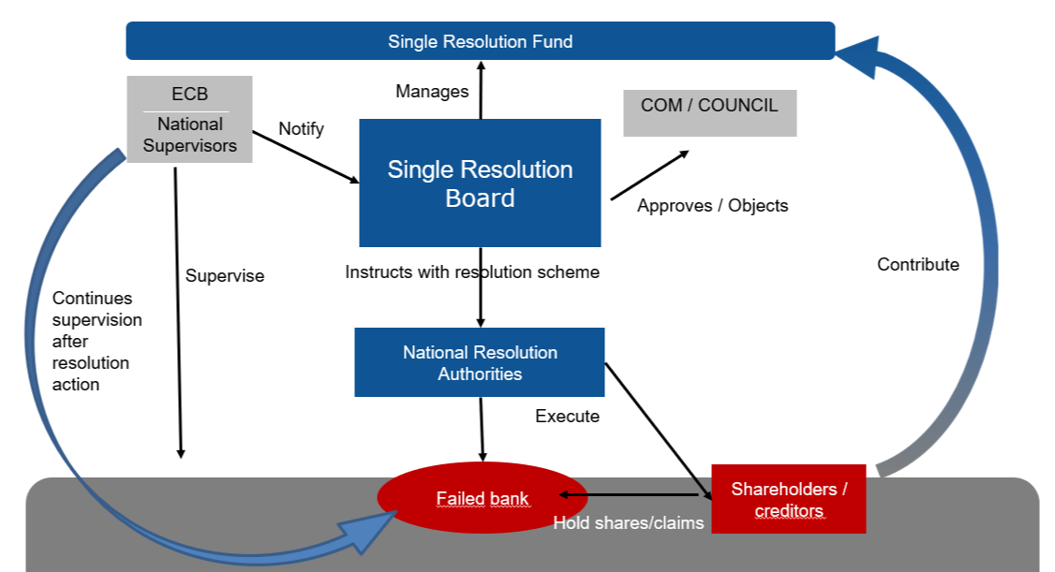
Stakeholders involved

Slide 19
REFORM of CMDI framework (2023)
  Legislative proposal to revise BRRD, SRMR and DGSD published by the European Commission in April 2023
  Draws on lessons learned from the first years of application of the framework: improving the ability to deal with the failure of small and medium-sized banks
  Broaden scope of resolution (criticality at regional, not only national level)
  Facilitate use of DGS funding (e.g., general instead of tiered depositor preference, harmonization of least cost test)
  Legislative process: European Parliament and Council

Slide 20
What worked and what did not?
US & EU Experiences

Slide 21
The Failure and Resolution of
Silicon Valley Bank
Lisa Schweitzer
lschweitzer@cgsh.com
Cleary Gottlieb Steen & Hamilton LLP
June 11, 2023

Slide 22
An unprecedented storm
  “On March 9, SVB lost over $40 billion in deposits, and SVBFG management expected to lose over $100 billion more on March 10. This deposit outflow was remarkable in terms of scale and scope and represented roughly 85 percent of the bank’s deposit base. By comparison, estimates suggest that the failure of Wachovia in 2008 included about $10 billion in outflows over 8 days, while the failure of Washington Mutual in 2008 included $19 billion over 16 days.”
  -Federal Reserve Board April 2023 report

Slide 23
Timeline
Silicon Valley Bank (“SVB”) completes sale of available-for-sale securities at a $1.8 billion loss
Announces offering of $1.25 billon in common stock and $500 million in depositary shares
FDIC appointed receiver for SVB and initially announces it would transfer only insured deposits of SVB to the newly chartered Deposit Insurance National Bank of Santa Clara (the “DINB”)
1 | 2 | 3 | 4 | 5 | 6 | 7 | 8 | 9 | 10 | 11
MARCH
1 | 2 | 3 | 4 | 5 | 6 | 7 | 8 | 9 | 10 | 11
Withdrawal request for deposits equivalent to almost 25% of SVB’s total deposits

Slide 24
Timeline
FDIC transfers all deposits to newly created bridge bank (Silicon Valley Bridge Bank, N.A.)
Customers regain full access to their accounts
All QFCs transferred to bridge bank
Germany’s BaFin announces certain restrictions on SVB Germany Branch
SVB Financial Group, the parent company of SVB, announces a board-appointed restructuring committee
HSBC buys SVB UK subsidiary for £1, protecting depositors and avoiding need for UK Bank Insolvency Procedure (“BIP”) process
12 | 13 | 14 | 15 | 16 | 17 | 18 | 19 | 20 | 21 | 22 | 23 | 24 | 25 | 26 | 27
MARCH
12 | 13 | 14 | 15 | 16 | 17 | 18 | 19 | 20 | 21 | 22 | 23 | 24 | 25 | 26 | 27
FDIC auction of SVB to find acquirer—none found
Regulators approve systemic risk exception to fully protect all SVB depositors
Federal Reserve announces a Bank Term Funding Program (“BTFP”) with Treasury backstop of $25 billion
Canadian authorities take temporary control (later permanent control) of SVB Canada
SVB Financial Group (“SVBFG”) files for Chapter 11 bankruptcy
First-Citizens Bank & Trust Company, Raleigh, NC acquires all deposits and loans of Silicon Valley Bridge Bank, N.A. under a P&A agreement
All “loan-related” QFCs are transferred as part of the P&A Agreement

Slide 25
Factors Contributing to Crisis
  Factors contributing to the failure of SVB appear to have included, but are not limited to:
  Failures of management
  Rapid growth of the banking organization
  Slow remediation of issues identified by supervisors
  High proportion of uninsured deposits, and industry concentration
  Inadequate management of interest rate risk/significant increases in Treasury interest rates
  Insufficient operational readiness
  Speed of withdrawals
  Supervisory shortcomings and regulatory/legislative change and changes in supervision
  “On March 9, SVB lost over $40 billion in deposits, and SVBFG management expected to lose over $100 billion more on March 10. This deposit outflow was remarkable in terms of scale and scope and represented roughly 85 percent of the bank’s deposit base. By comparison, estimates suggest that the failure of Wachovia in 2008 included about $10 billion in outflows over 8 days, while the failure of Washington Mutual in 2008 included $19 billion over 16 days.”
  -Federal Reserve Board April 2023 report

Slide 26
Signature Bank and First Republic Failures
  Signature Bank
    March 12, 2023 – FDIC appointed receiver of Signature Bank by the New York State Department of Financial Services.
      FDIC transfers all deposits and substantially all assets to Signature Bridge Bank, N.A.
      Along with BTFP, Federal Reserve announces that discount window borrowing can take place at par
    March 20, 2023 – Flagstar Bank, N.A. enters into P&A Agreement for Signature Bridge Bank
    April 3, 2023 – FDIC announces upcoming sale for later this summer of Signature Bank loan portfolio retained in receivership
  First Republic Bank
    After the failures of SVB and Signature, wide speculation that First Republic Bank will fail as the Bank’s shares fall
    March 16, 2023 – 11 banks including Bank of America, Citigroup, and Goldman Sachs announce they will place $30 billion of uninsured deposits at First Republic
    Rumors and speculation of failure continue through April
    May 1, 2023 – DFPI announces that it has closed First Republic and appointed FDIC receiver. FDIC simultaneously announces that JPMorgan Chase Bank, N.A. has entered into a P&A Agreement to assume all of First Republic’s deposits and substantially all its assets
  Depositors in both cases were paid in full

Slide 27
What worked and what did not?
European Experiences
Banco Popular (Spain), a BRRD success story?

Slide 28


BACKGROUND
Banco Popular Español
(Spain)
6th largest banking group in Spain
Active in entire territory:
> 1.600 branches in Spain
> 10.000 employees
Total Assets: EUR 147 bln
Banco Pastor
(Spain)
Popular Banca Privada
(Spain)
Banco Popular Portugal
(Portugal)
Totalbank
(U.S.)

Slide 29
FOLTF DETERMINATION
Reasons for FOLTF determination:
Significant cash outflows:
Disclosure of need for extraordinary provisions (2016 Annual Rep., published Feb 2017)
New Chairman (February 2017)
Public statement about results of internal audits with potentially significant impact on financial statements; CEO replaced after less than one year (April 2017)
Rating downgrades in February (DBRS) and April 2017 (Standard & Poor’s, Moody’s)
Announcement that it would not pay dividends (April 2017)
Publication of quarterly results: worse than expected (May 2017)
Breach of Liquidity Coverage Ratio (LCR)
Continuous negative press coverage
Conclusion ECB:
BPE is likely in the near future to be unable to pay its debts or other liabilities as they fall due

Slide 30
OTHER RESOLUTION CONDITIONS
No alternative measures which could prevent failure:
BPE itself had indicated that it is FOLTF (letter to ECB)
Private sale process had not led to a positive result
Unlikely that BPE could mobilize sufficient liquidity through market operations / ECB within the short timeframe
No early intervention measures that could immediately solve liquidity situation
WDCI would not be sufficient to restore the liquidity situation
Resolution is in the public interest:
Necessary to ensure continuity of critical functions (deposit-taking from households and SMEs, lending to SMEs, payment and cash services)
Necessary to avoid significant adverse effects on financial stability (size and relevance)
Normal insolvency proceedings would not achieve the above-mentioned objectives to the same extent

Slide 31
TOOLS AND POWERS APPLIED
STEP 1:
Write down and conversion of capital instruments
(Art. 21 SRMR)
STEP 2:
Sale of business tool (Art. 24 SRMR)
Cancellation of 100% of shares
(~€ 2 bln)
Conversion of Additional Tier 1 instruments into newly issued New Shares 1 (€ 1,35 bln)
Cancellation of 100% of New Shares 1
Conversion of Tier 2 instruments into newly issued New Shares 2
(€ 684 mln)
- Transfer of 100% of New Shares 2 to Banco Santander for the purchase price of € 1
Valuation 2: economic value between € -8,2 and € 1,3 bln, best estimate € -2 bln

Slide 32

PROCEDURE
MAY
MAY
JUNE
JUNE
JUNE
JUNE
JUNE
18
23
02
03
05
06
07
SRB asks updated information from the ECB
SRB hires Deloitte for independent valuation
(and asks further information from BPE)
ECB informs SRB that situation is worsening
SRB asks information about private sale process
SRB initiates marketing procedure
(decision addressed to FROB)
2 potential purchasers access VDR and receive sale documents
(sale process letter)
ECB FOLTF assessment
Board of BPE informed ECB it was FOLTF
Valuation 2 finalised
1 binding offer: € 1 (Santander)
SRB adopts resolution scheme
EC endorsement
Close cooperation with the NRA, the ECB and the EC throughout the process

Slide 33

https://www.unidroit.org/work-in-progress/bank-insolvency/

Slide 34
Moving Forward: Following this round of bank failures and rescues, regulators and private actors will consider:
  1) Should small banks as a default really go into liquidation?
  2) How can regulators bolster the resilience of non-GSIBs?
    Should capital and liquidity requirements for smaller banks be increased?
    What will be the impact on their business model and competitiveness?
    How can the regulatory framework be strengthened? Are new regulations necessary?
  3) Which risk indicators at a financial institution should be monitored more closely?
  4) (How) should resolution planning be updated to account for recent experience?
  5) Can you be small, safe and profitable? Who should bear costs of supervision?
  6) What is the role of deposit guarantee schemes, and should they be expanded?
  7) Is there anything that should be done to prevent or slow down a run on a bank?
  8) Central banks in dual capacity: regulator and ‘controlling the monetary tides’

Slide 35


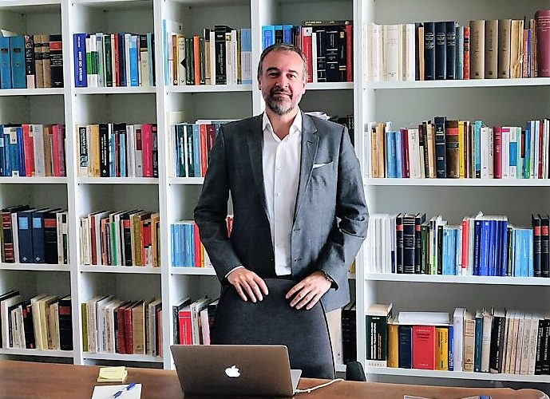
Thank you!

